Slide 1
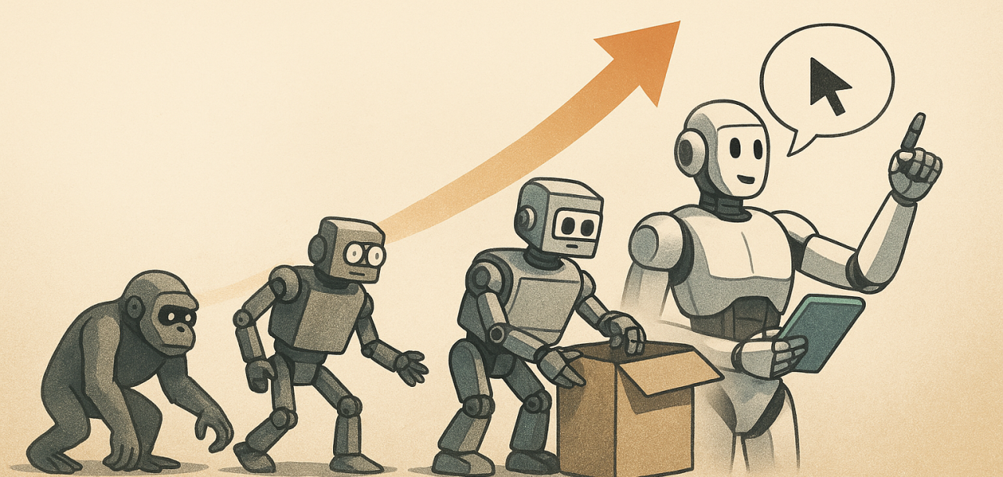
Diffusion Policies and Vision-Language-Action (VLA) Models

Slide 2
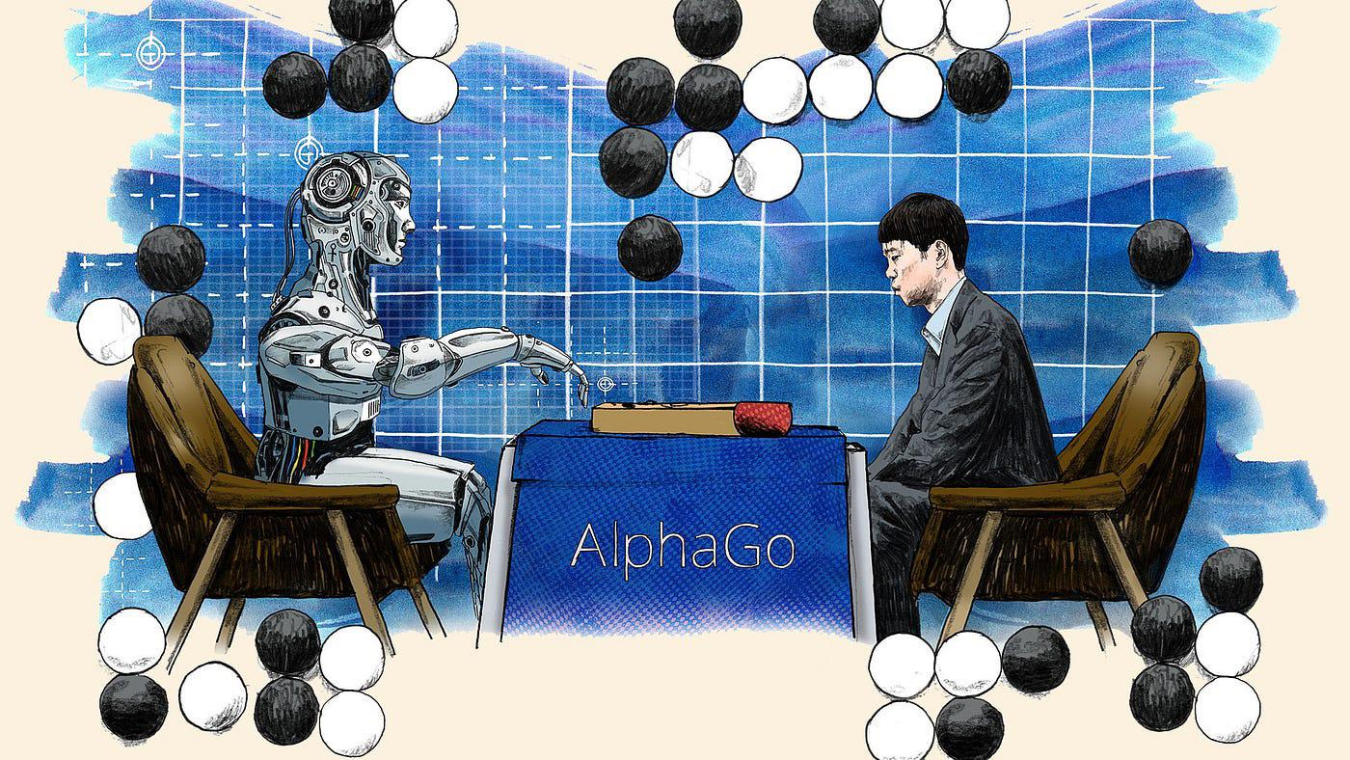
Classical Reinforcement Learning / Control

Slide 3
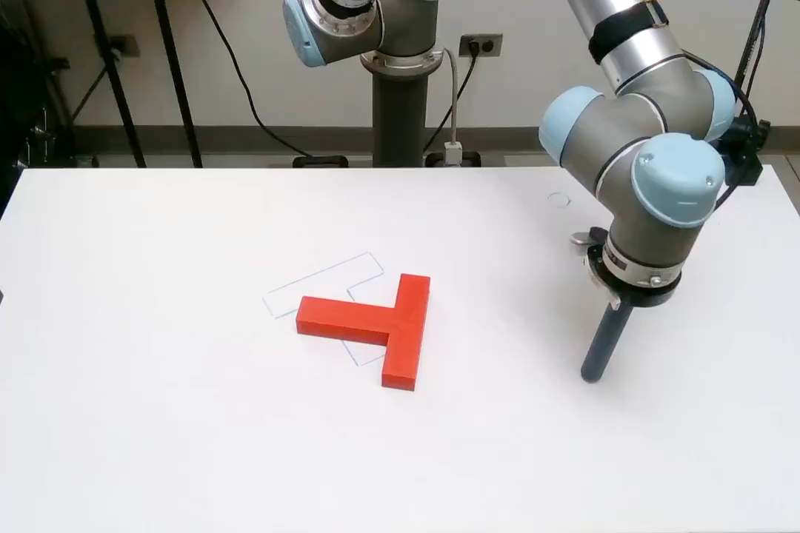
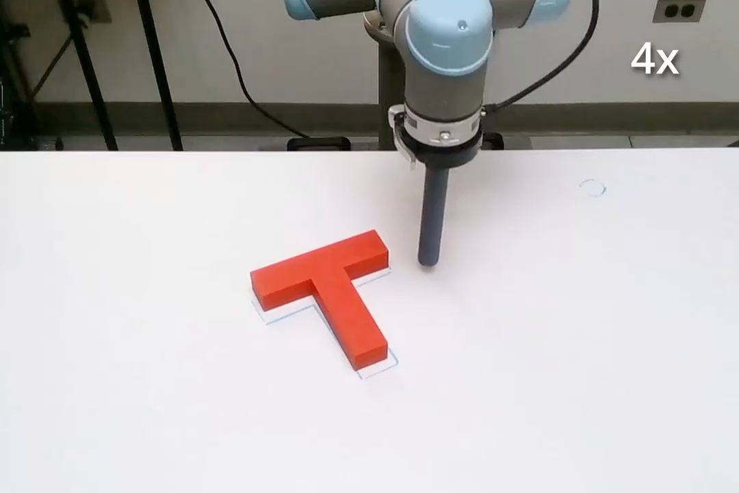
Replacing Policy Network by Diffusion
Fail
Succeed
-- Credit: Chi et al., Diffusion Policy: Visuomotor Policy Learning via Action Diffusion, 2023

Slide 4
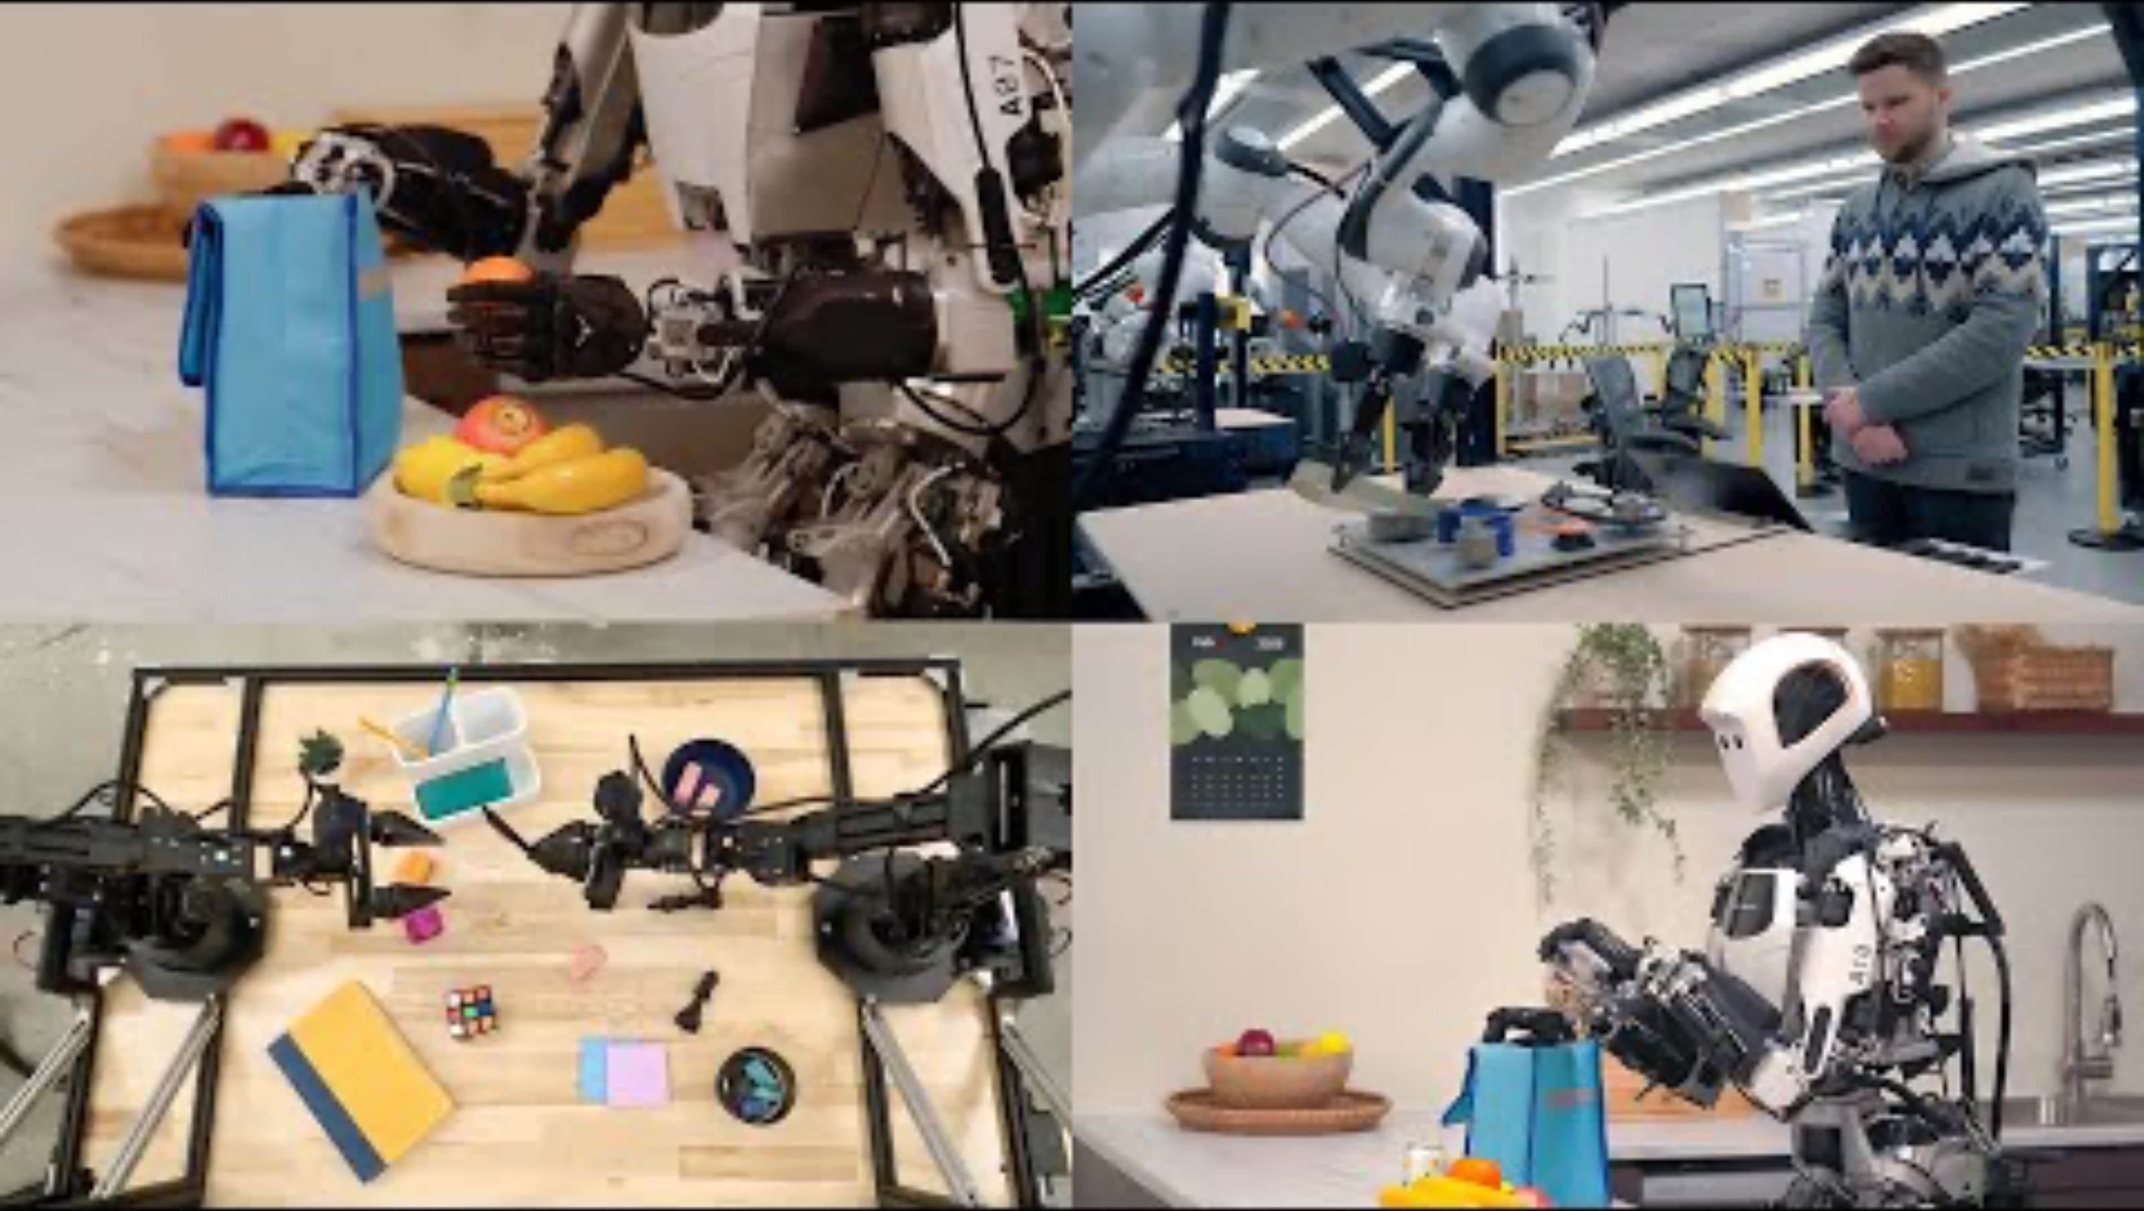
Demo of Generalist Robotics

Slide 5
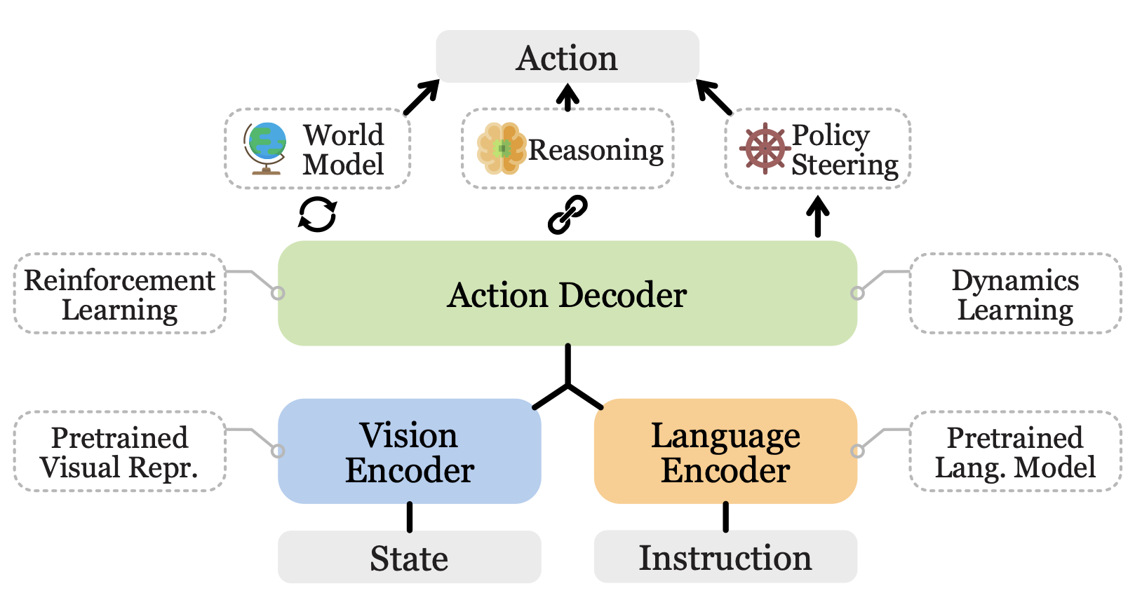
VLA System Architecture
-- Credit: Ma et al., A Survey on Vision-Language-Action Models for Embodied AI, 2026

Slide 6
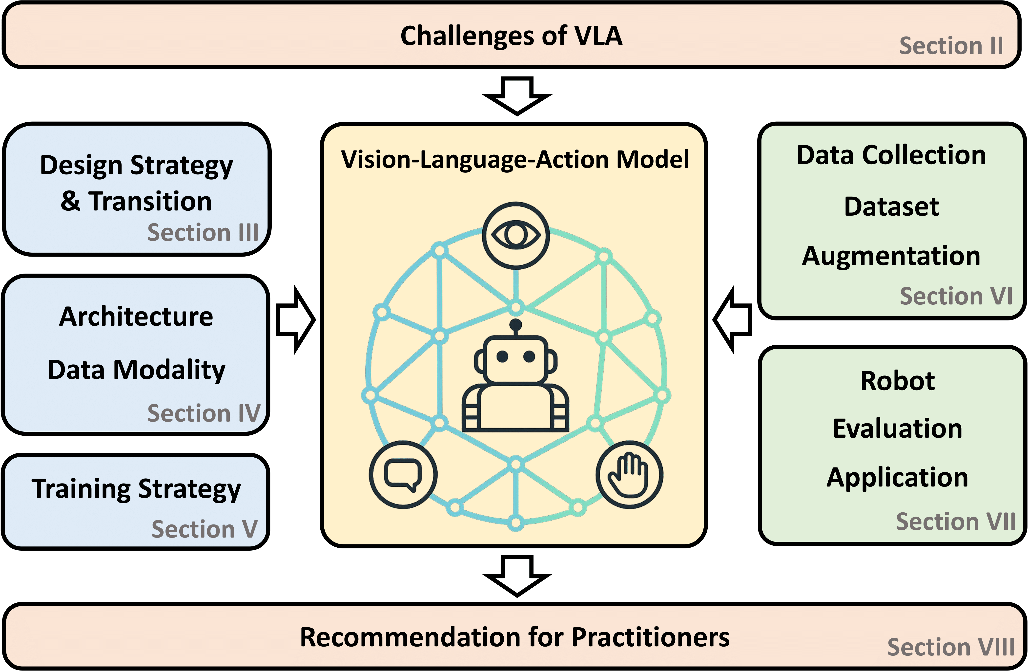
VLA Research Overview
-- Credit: Kawaharazuka et al., Vision-Language-Action Models for Robotics:
A Review Towards Real-World Applications, 2025

Slide 7
Some Research Directions

Slide 8
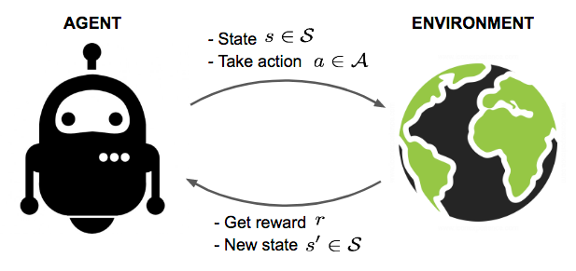
Diffusion Policy in Markov Decision Process
Trajectory
Optimal policy

Slide 9

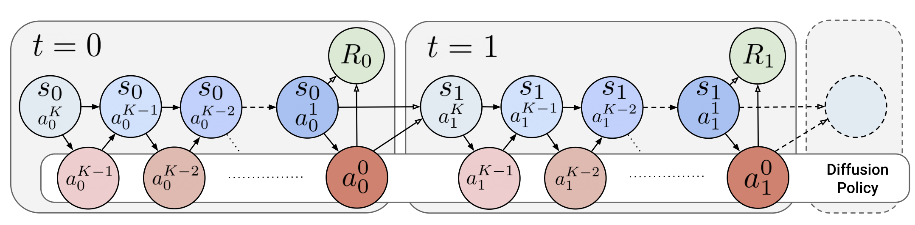
Policy Gradient in Diffusion Model
Policy gradient formula
Embed diffusion backward process into the original MDP
-- Credit: Ren et al., Diffusion Policy Policy Optimization, 2024

Slide 10
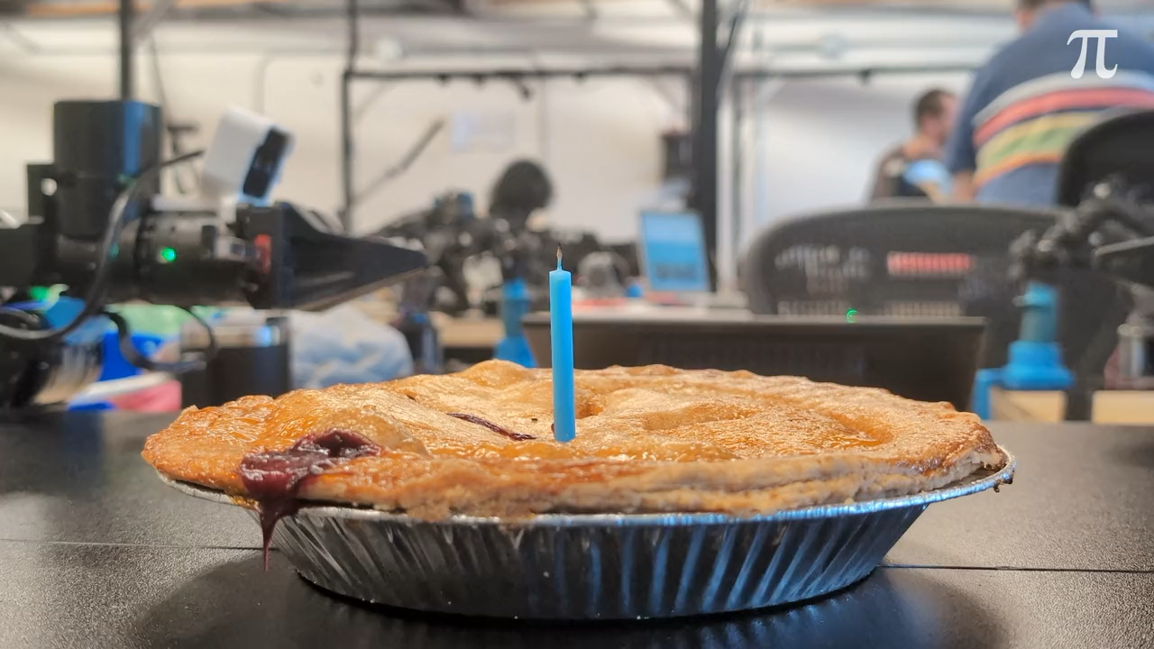
Action Chunk and Model Predictive Control
Instead of predicting one action, multiple steps are predicted
-- Credit: Black et al., Real-Time Execution of Action Chunking Flow Policies, 2025

Slide 11
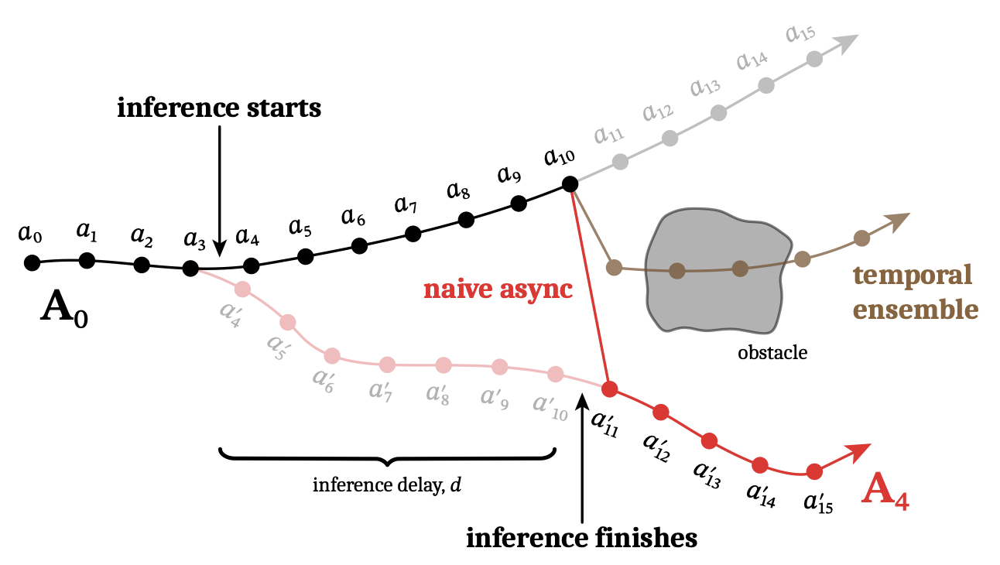
Inference Latency
It takes time for diffusion model to generate action(s)
-- Credit: Black et al., Real-Time Execution of Action Chunking Flow Policies, 2025

Slide 12
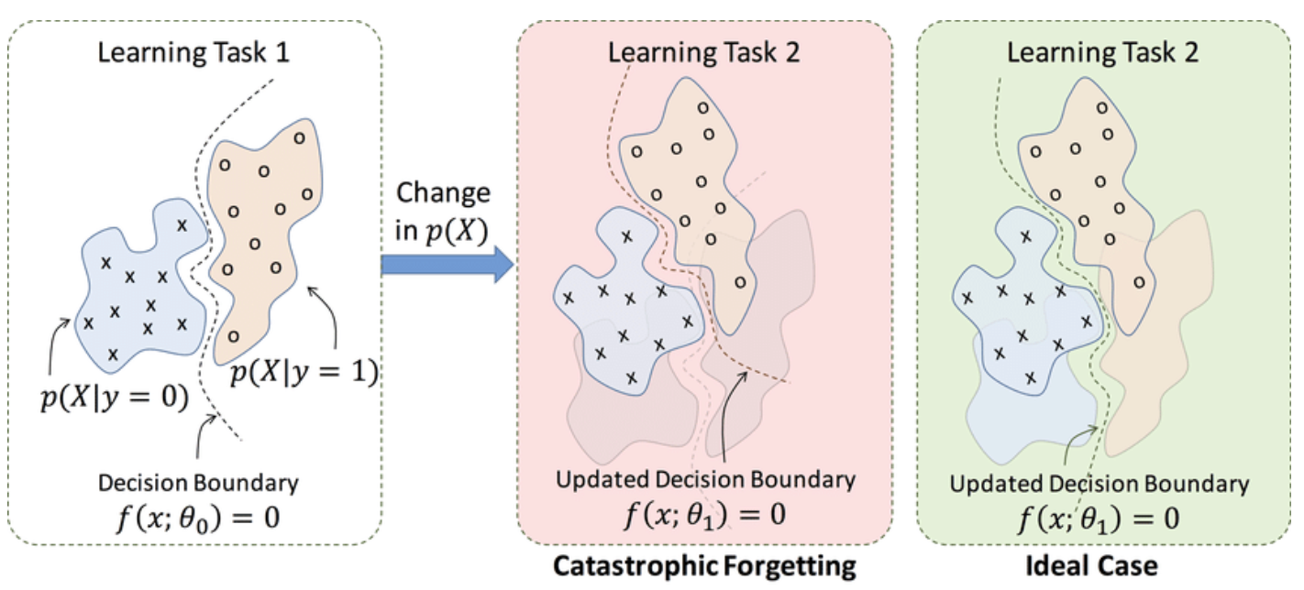
Continual Learning in Generalist Robotics
Continual learning, or lifelong learning, is an AI training approach enabling models to learn from a continuous stream of data, acquiring new knowledge without forgetting previously learned tasks

Slide 13
Continual Learning Setup and Methodology
At the core, continual learning is to fine-tune pre-trained models, with an essential criterion that the model should maintain performance in past tasks
Learn over a sequence of K tasks
Optimal policy is to minimize the average performance on all the tasks

