Slide 1
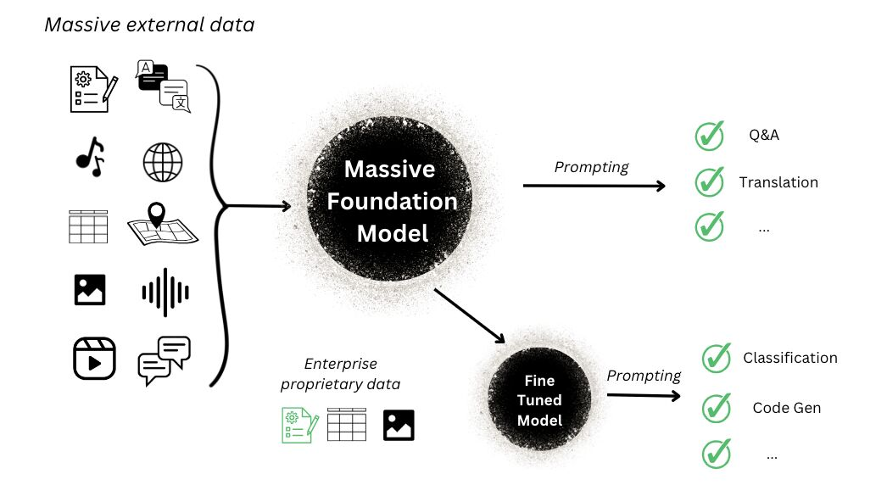
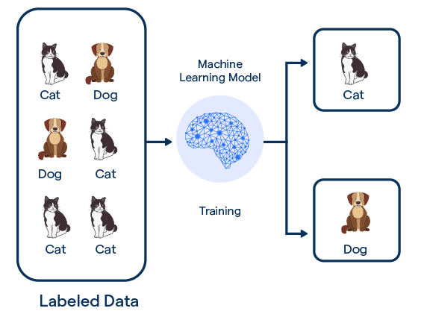
A New Training Paradigm
-- Thanks to blogs from BotPenguin and Humanloop

Slide 2


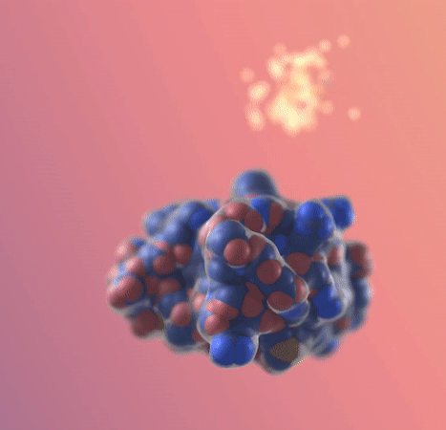
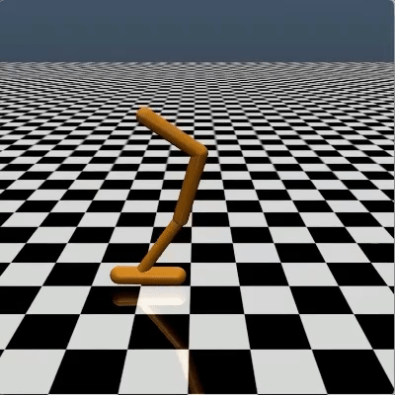
Transformative Power of Fine-Tuning
ChatGPT
Sora
RFDiffusion
Decision Diffuser
Language
Video
Biology
RL/control
Adapter (Houlsby et al., 2019), LoRA (Hu et al., 2022), Supervised fine-tuning (Ouyang et al., 2022), RLHF (Ouyang et al., 2022), Distillation (Poole et al., 2022), …
Gap: Methodology focused; limited theoretical guarantees

Slide 3
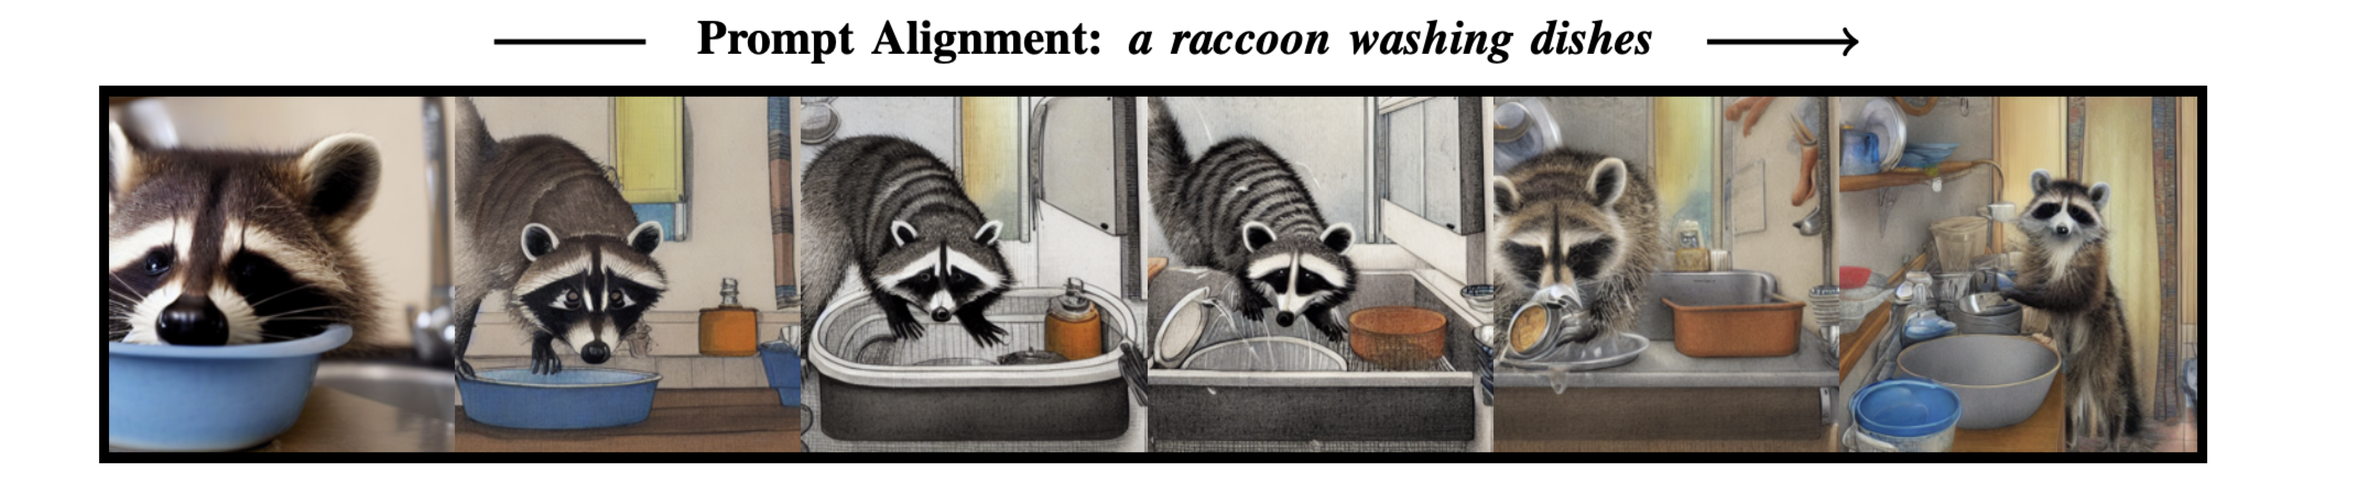
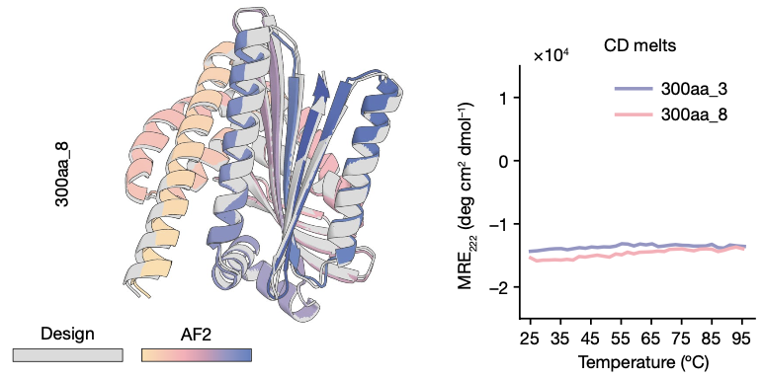
From to
Text-to-image generation (Black et al., 2023)
Protein generation with biochemical properties (Watson et al., 2023; Gruver et al., 2023)

Slide 4
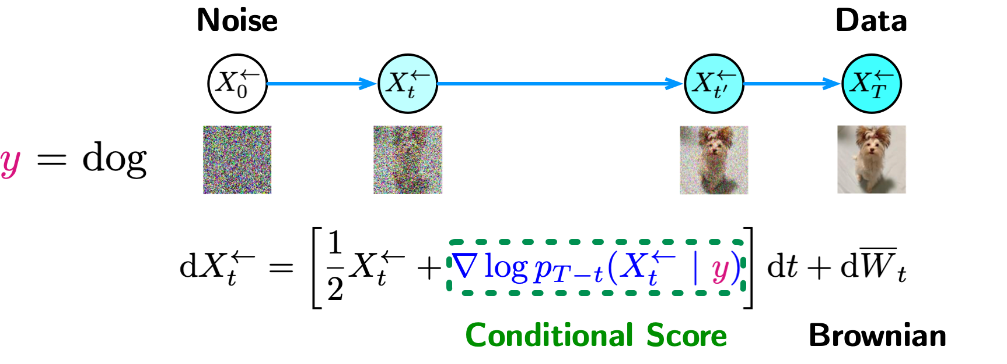
Conditional Diffusion Models
Conditioned sample generation for a given label
Label
Diffusion models can handle diverse conditional information, e.g., text prompts, partial images, etc.
The key is to scalably estimate the conditional score
-- More in the survey: M. Chen, S. Mei, J. Fan, and M. Wang. “Challenges and Opportunities of Diffusion Models for Generative AI”. National Science Review 2024

Slide 5

Gradient Guidance
Definition
In general settings, given a gradient vector g, define gradient guidance as
where is some coefficient.
Data X is Gaussian. Reward function is linear .
Reward evaluation is noisy
with
Guidance calculation

Slide 6
Interpretation of Gradient Guidance
Gradient guidance steers diffusion model to close a “look-ahead” gap
Naïve gradient not working
Look-ahead Gap
Reward Improve

Slide 7
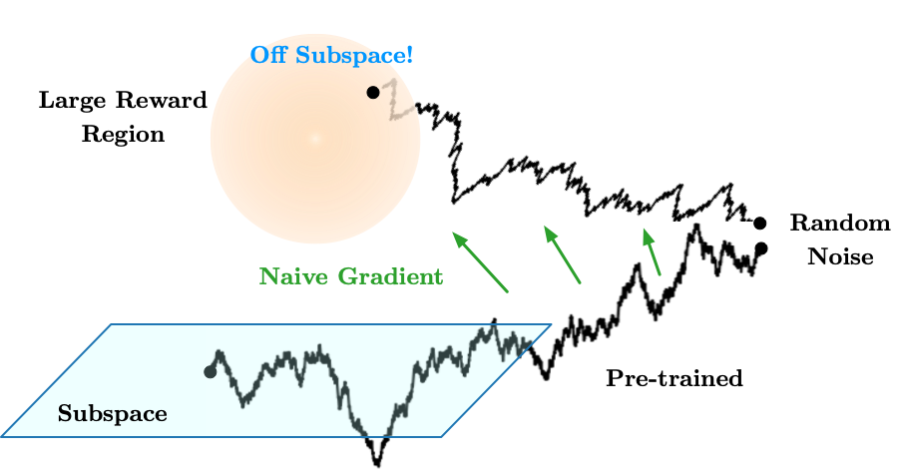
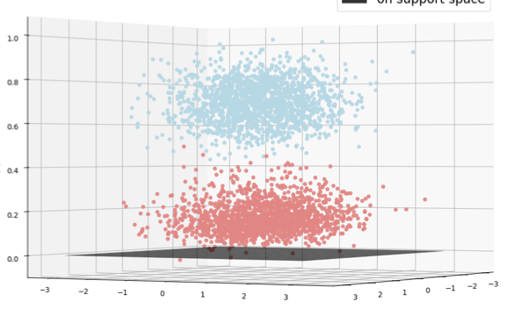
Gradient Guidance Preserves Structure
Gradient guidance preserves subspace structures, but naïve gradient deviates from the subspace
Pre-training induces projection
Naïve gradient
Gradient guidance

Slide 8
Implementing Gradient Guidance
Gradient guidance involves an unknown expectation
Tweedie’s formula (Efron, 2011)
Implementable gradient guidance
The gradient can be found by auto-differentiation
Coefficient is a tuning parameter, akin to a step size

Slide 9
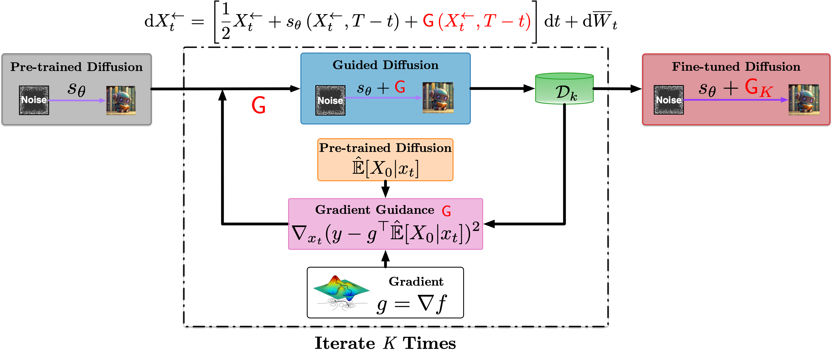
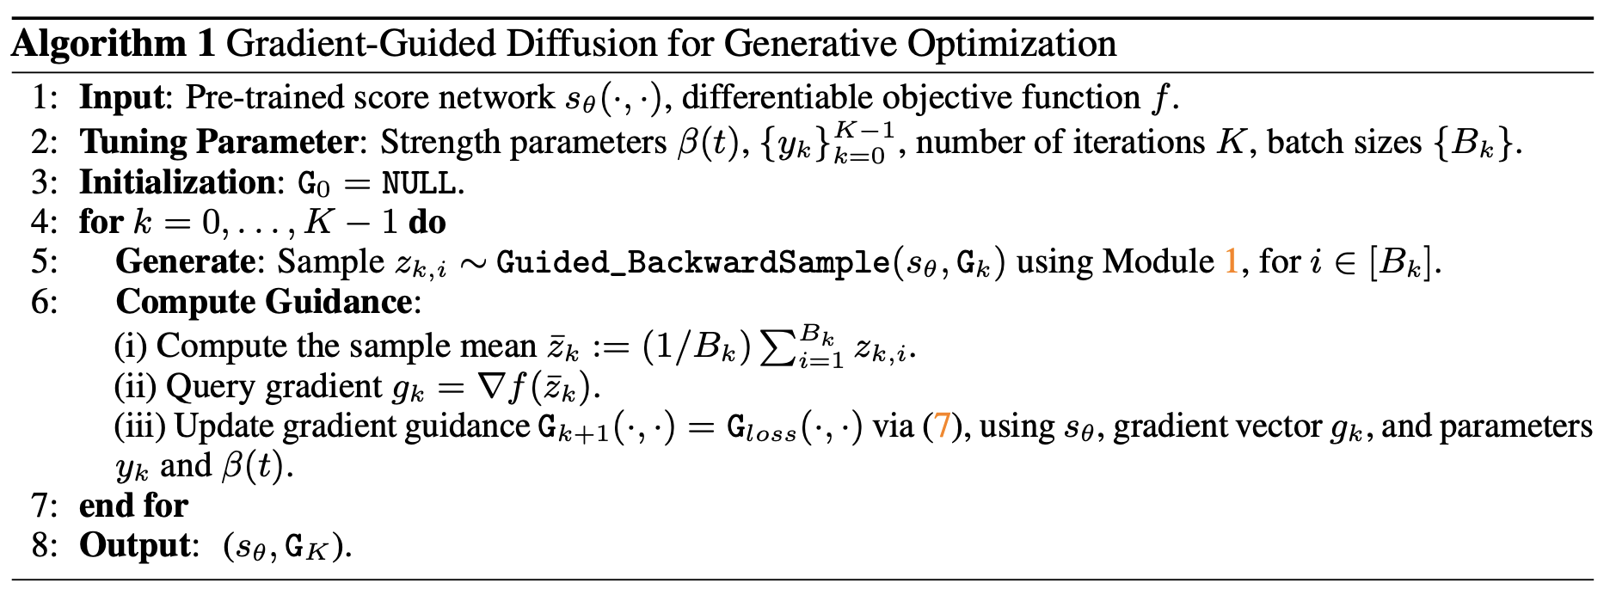
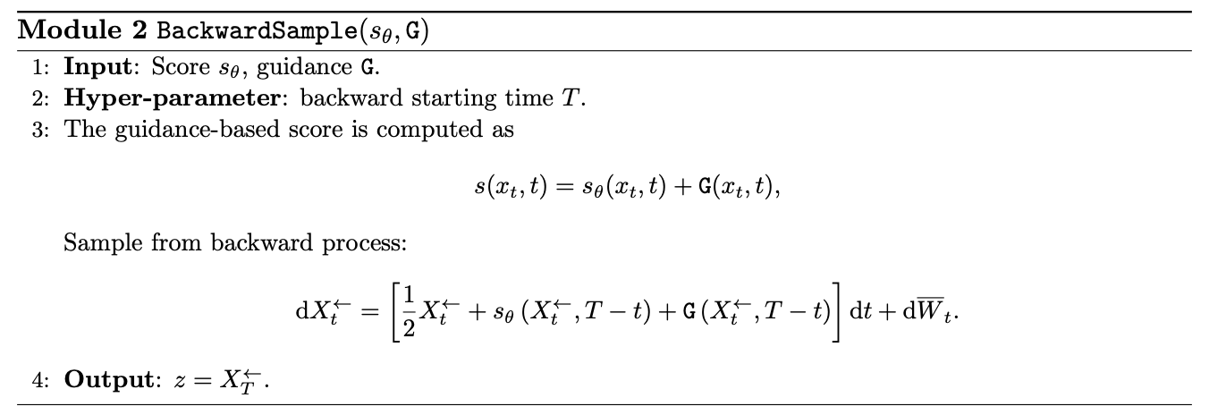
Gradient Guidance Algorithm

Slide 10
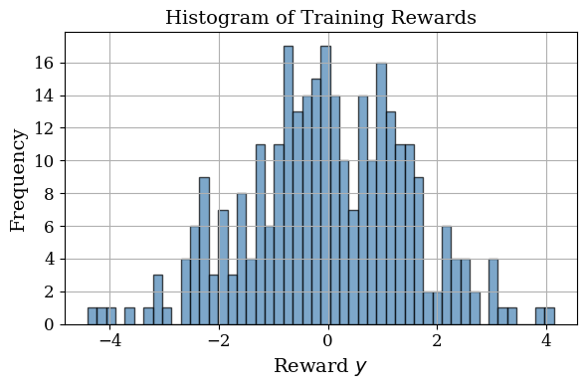
A Toy Example
2D data X with for
Linear reward

Slide 11
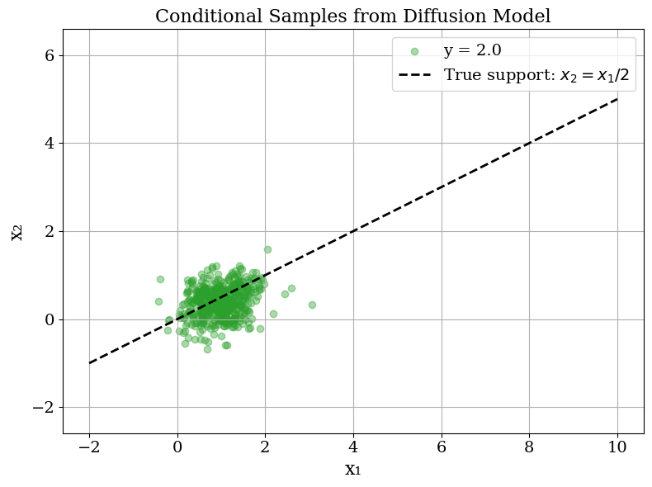
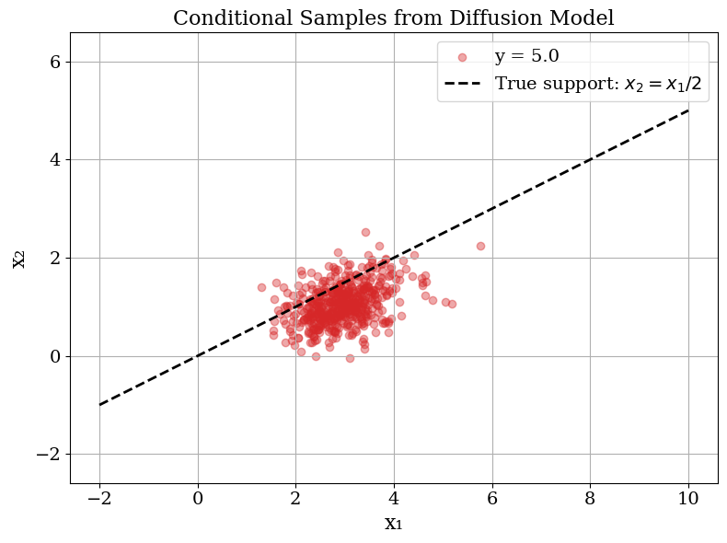
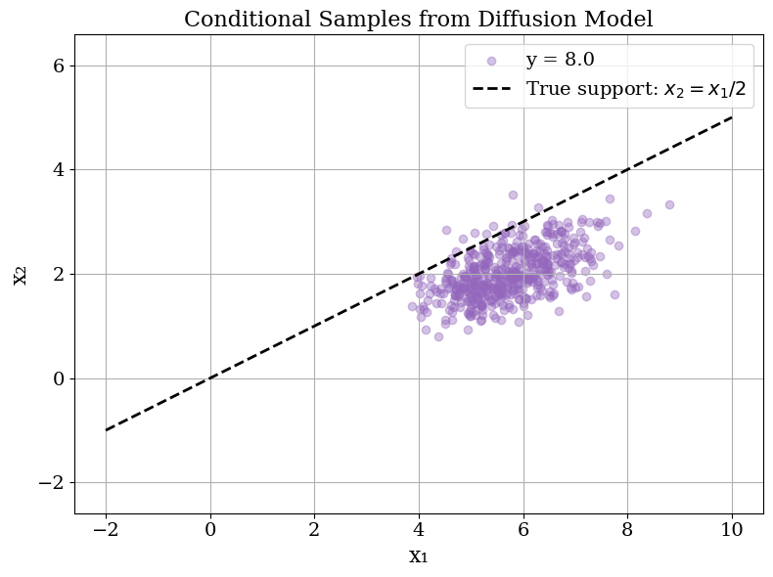
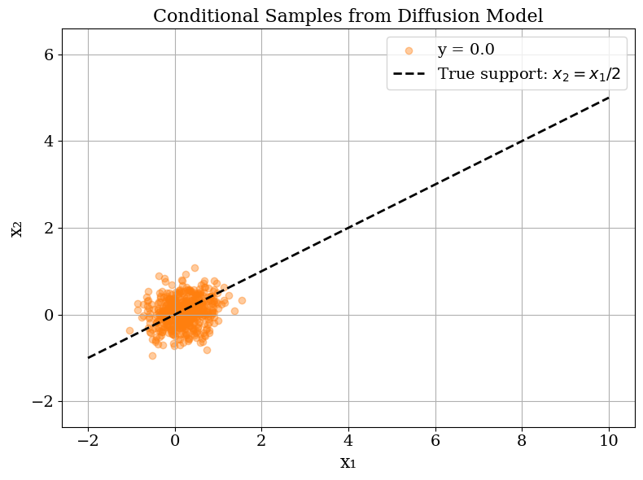

A Toy Example Cont’d: Good and Bad
Insufficient high reward coverage

Slide 12

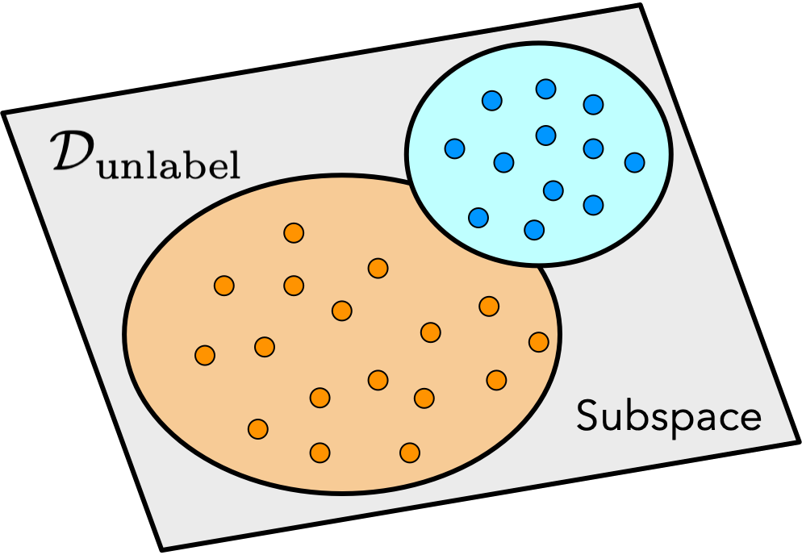
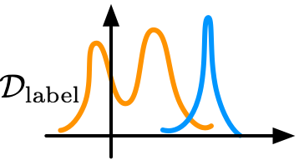
How Far Are We from The Target Reward
Let be the target reward of generation
(Reward estimation error)
(Reward distribution shift)
(Conditional diffusion error)
(Diffusion distribution shift)
Target
Target
Training
Training

Slide 13


Convergence to Regularized Optima
Theorem
Suppose the reward function is concave and L-smooth. Consider linear pre-trained score. With high probability, it holds
where , is the mean of generated samples, and is the maximizer of
with and the mean and covariance of the pre-training data.
Effective gradient-guided diffusion for optimization:
Linear convergence and intrinsic dimension dependence
Pre-training induces regularization

Slide 14
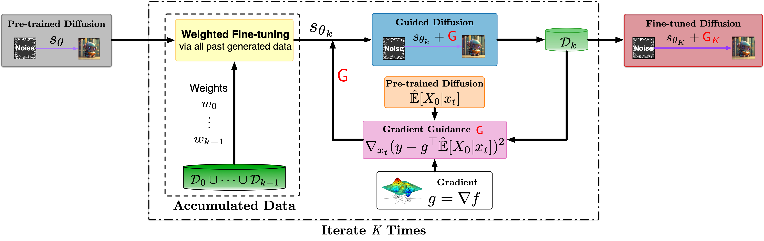
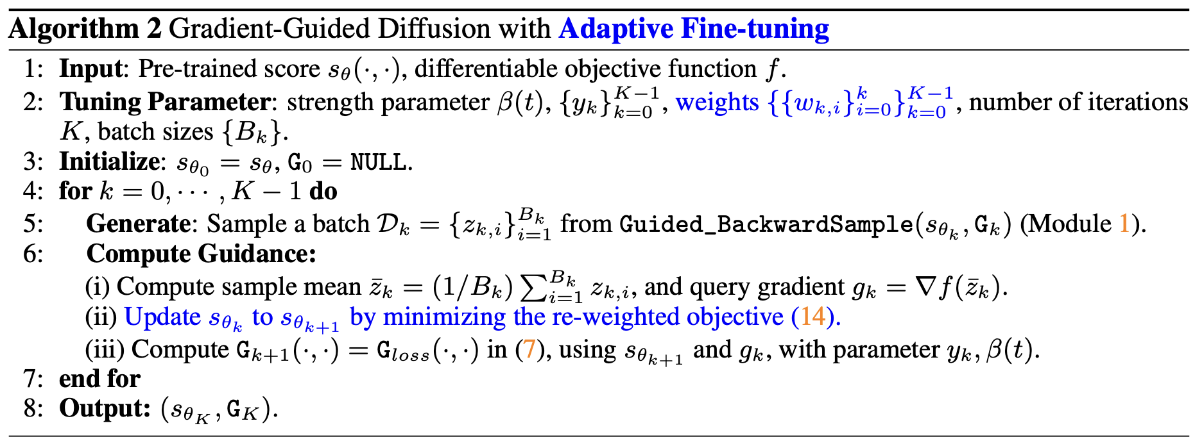
Algorithm with Adaptive Pre-trained Score

Slide 15
Global Convergence with Adapted Score
Theorem
Suppose the reward function is concave and L-smooth. Consider adapting a linear pre-trained score. It holds that
where is the global maximum.
Effective gradient-guided diffusion for optimization:
1/K global convergence
intrinsic dimension dependence
Preservation of subspace structure
-- Q. Ying, H. Yuan, Y. Yang, M. Chen, M. Wang. “Gradient Guidance for Diffusion Models”, NeurIPS 2024

